Slide 1
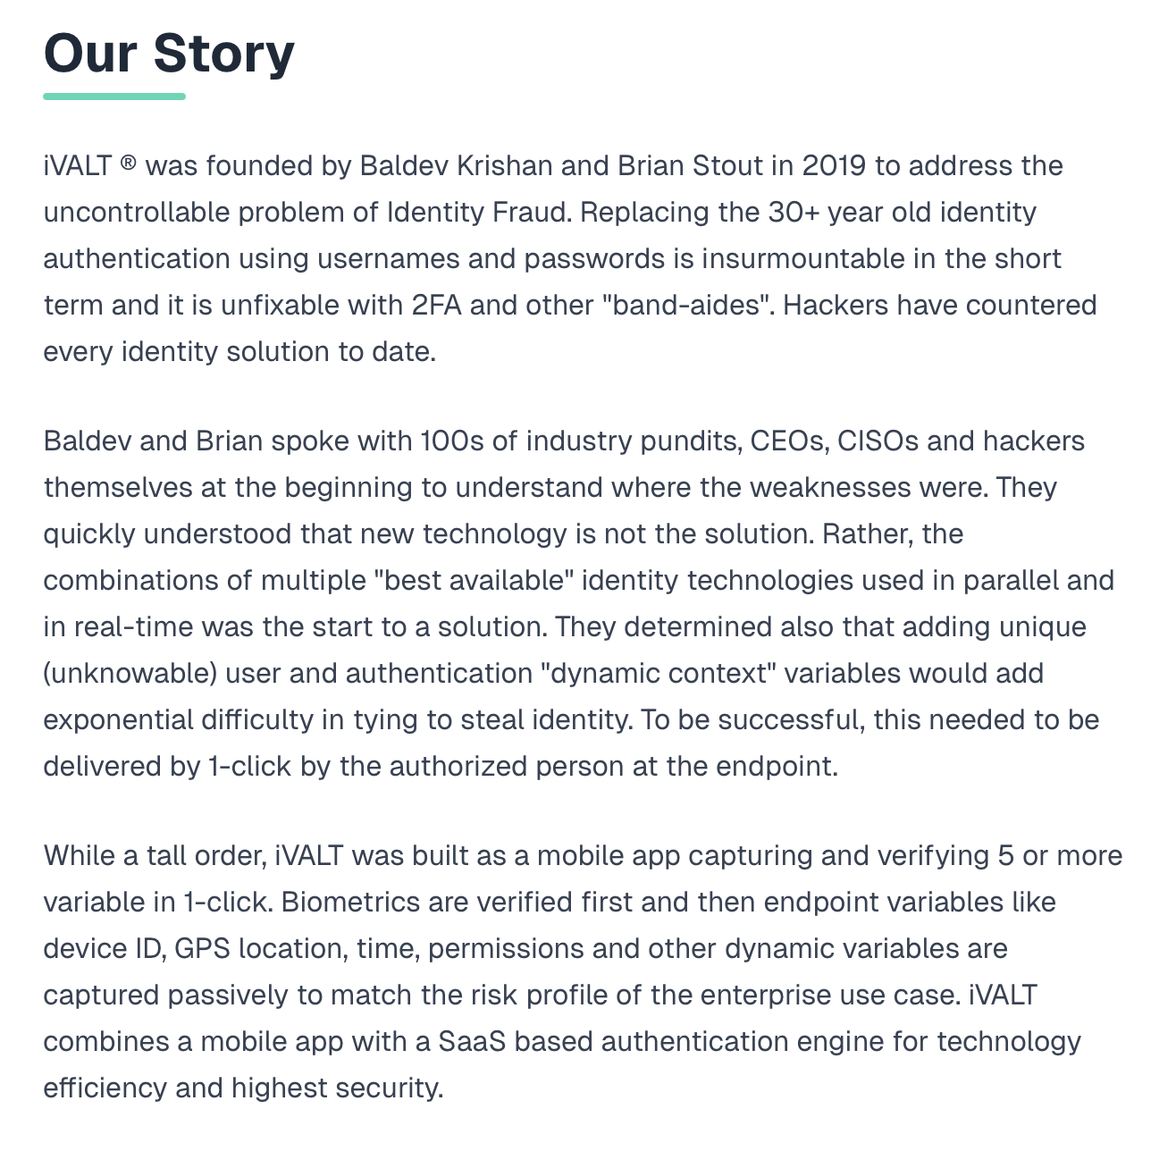
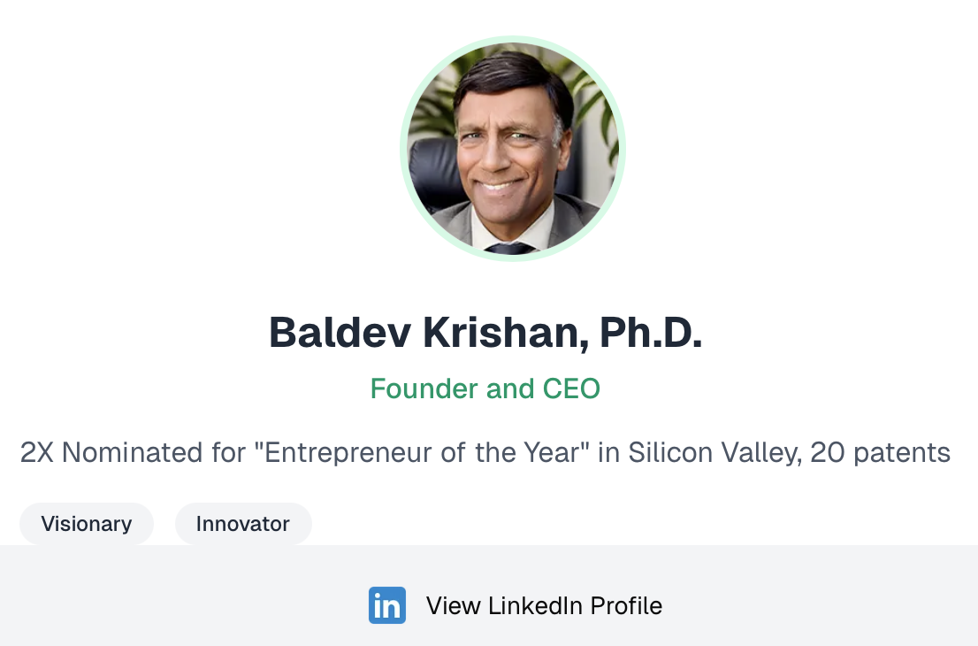

Pioneering the Future of Identity
Solution Components
Founded in 2019
Founders

Slide 2
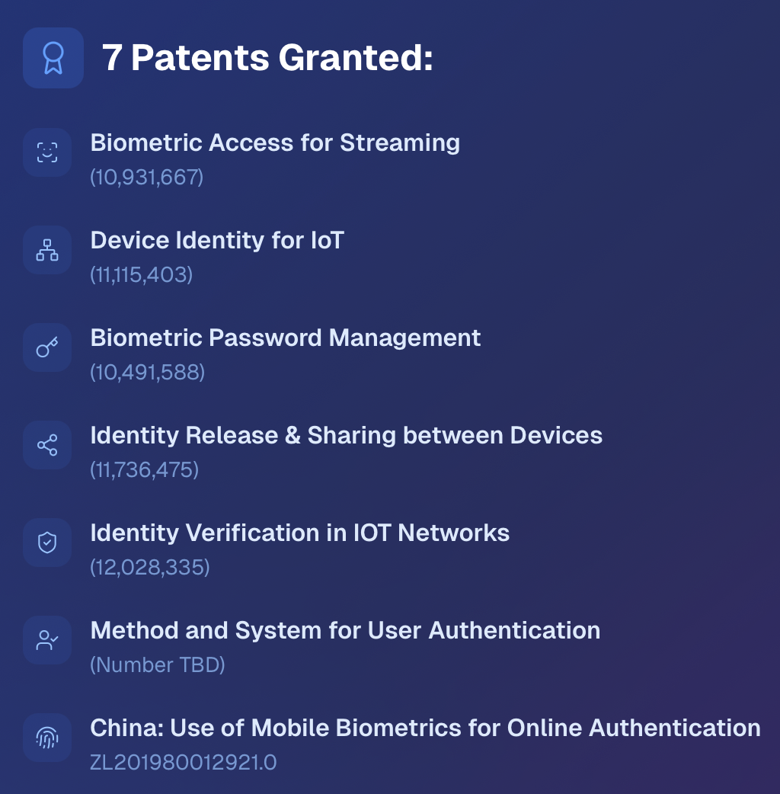
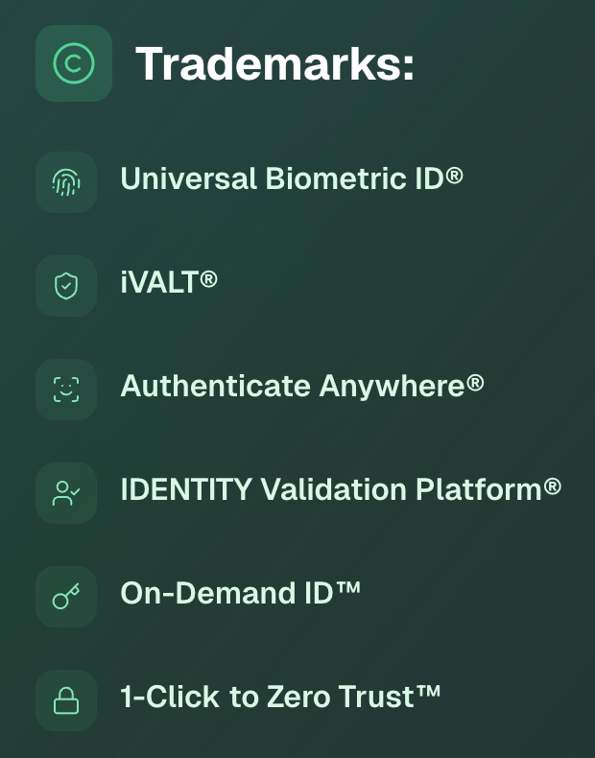
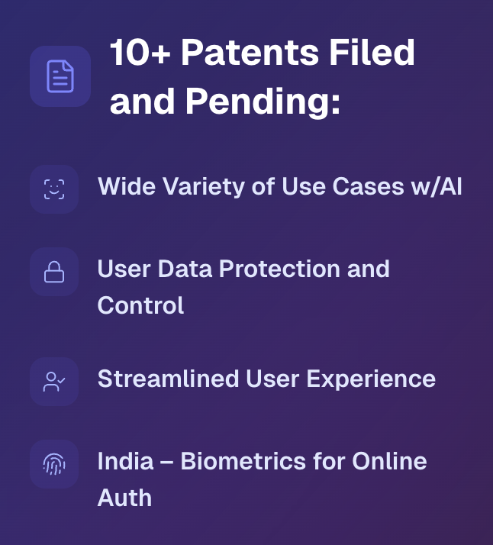
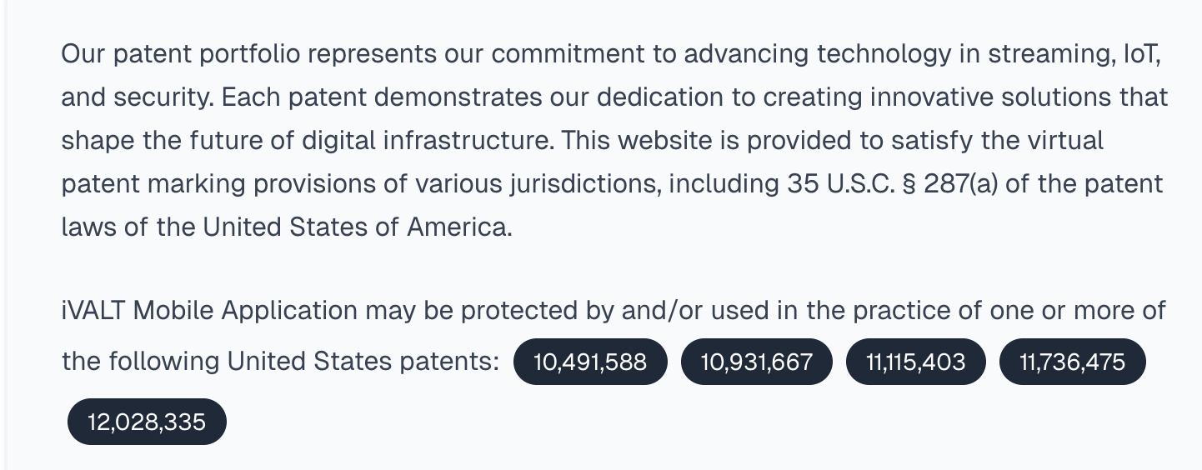
Intellectual Property

Slide 3
GTM Strategy
Build Value through World Class Partnerships and IP
Verticals, Technologies and Systems Integrators
Multiply Market Reach and Penetration
Prove World Class Flexibility and Extensibility
Lift Partner Solution ROIs, Differentiation, and Brand Value
Joint Product Development (e.g., Proactive ID and 1-Click KYC)
Help Orchestrate Significant Market “Disruption”
Start to Eliminate Legacy Identity Practices & Technology
Enable Mobile-Centric and User-Centric Shifts in Identity
Greatly Enhance Overall Enterprise Security
Set a New Standard of 1-Click for Complete Identity Verification

Slide 4
